Slide 1
TekInspect 1.0 Reviewer Training
An accelerated introduction to the
Tektronix Software Inspection Method
Philip M. Johnson
Collaborative Software Development Laboratory
Department of Information and Computer Sciences
University of Hawaii
Honolulu, HI
johnson@hawaii.edu
© 1996 Philip M. Johnson
Permission to redistribute and modify freely is granted as long as this copyright notice is retained.

Slide 2
My background
Industry Experience:
  1977-79, COBOL business applications programming.
  1980-81, Real-time compiler V&V (Ford Motor Co.)
  1981-83, Real-time signal processing (VA Hospitals)
  1986-87, AI systems development (BBTech, Inc.)
  1990-present, software engineering consultant
Academic Experience:
  Director, Collaborative Software Development Lab:
    http://www.ics.hawaii.edu/~csdl/
  Editor, WWW FTR Archive and SIRO Home Pages:
    http://www.ics.hawaii.edu/~johnson/FTR/
    http://www.ics.hawaii.edu/~siro/
  Java-based technology for software engineering support.

Slide 3
Goals of the course
Understand basic principles of formal technical review.
Learn one example review method (TekInspect) in detail.
Practice TekInspect on real materials.
Know where to go for more information.

Slide 4
Course structure
9:00 - 10:15: Principles of FTR
10:30-12:00: The TekInspect method
12:00-1:00: Lunch Break
1:00 - 2:45: Practice preparation and review meeting.
3:00 - 3:30: Wrapup and evaluation.

Slide 5
What is Formal Technical Review?
A method involving a structured encounter in which a group of technical personnel analyzes or improves the quality of the original work product as well as the quality of the method.
We will use “FTR” or simply “review” as an abbreviation for “formal technical review” in this training.

Slide 6
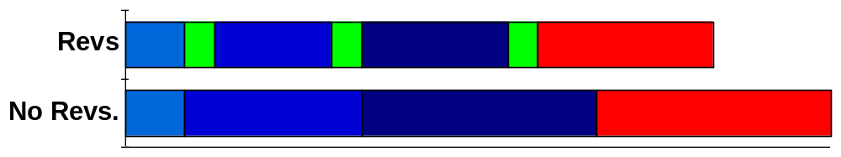
Basic Review Principles:
Why review? We test!
Reviews improve schedule performance
Reviews reduce rework.
  Rework accounts for 44% of development cost!
  Reqs (1%), Design (12%), Coding (12%), Testing (19%)
Reviews are pro-active tests.
  Find errors not possible through testing.
Reviews are training.
  Domain, corporate standards, group.
R
R
R
Req
Design
Code
Test

Slide 7
Basic Review Principles:
Why review? Who benefits?
Formal technical review provides:
  Defect information to the author.
  Information on work product and development to peers.
  Fault likelihood data to testers.
  Product status to management.
  Process status to SPI group.

Slide 8
Basic Review Principles:
FTR is well-defined
Well-defined process
  Phases (orientation, etc.)
  Procedures (checklists, etc.)
Well-defined roles
  Moderator, Reviewer, Scribe, Author, etc.
Well-defined objectives
  Defect removal, requirements elicitation, etc.
Well-defined measurements
  Forms, consistent data collection, etc.

Slide 9
Basic Review Principles:
Effective quality improvement
Reviews can find 60-100% of all defects.
Reviews are technical, not management; cannot be used for employee evaluation!
Review data is used to assess/improve quality of:
  work product
  software development process
  review process
Reviews reduce total project cost, but have non-trivial cost (~15%)
Upstream defect removal is 10-100 times cheaper.
Reviews disseminate domain knowledge, development skills, and corporate culture.

Slide 10
Basic Review Principles:
Industry Experience
Aetna Insurance Company:
  FTR found 82% of errors, 25% cost reduction.
AT&T:
  14% increase in productivity, 90% decrease in errors.
Bell-Northern Research:
  Inspection cost: 1 hour per defect.
  Testing cost: 2-4 hours per defect.
  Post-release cost: 33 hours per defect.
Hewlett-Packard
  Estimated cost savings from inspection (1993): $21,454,000
IBM (using Cleanroom)
  C system software
  No errors from time of first compile.

Slide 11
Basic Review Principles:
Who, What, and When
Who decides what should be reviewed?
  Senior technical personnel, project leader
What should be reviewed?
  Work products with high impact upon project risks.
  Work products directly related to quality objectives.
  “Upstream” work products have higher impact.
When should review be planned?
  Specify review method and target work products in software development plan/quality plan.

Slide 12
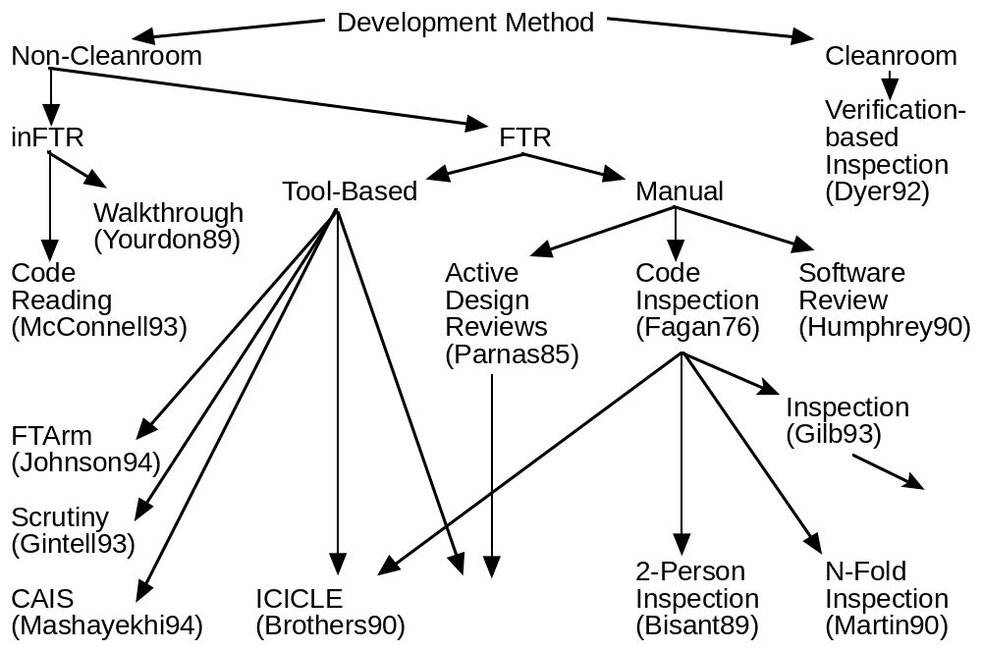
Basic Review Principles:
The range of review practice
TekInspect

Slide 13
Tektronix Review Methods
Method Family
Typical Goals
Typical Attributes
Minimal overhead
Developer training
Quick turnaround
Little/no preparation
Informal process
No measurement
Not FTR!
Walkthroughs
Requirements elicitation
Ambiguity resolution
Training
Formal process
Author presentation
Wide range of discussion
Technical Reviews
Formal process
Checklists
Measurements
Verify phase
Inspections
Detect and remove all defects efficiently and effectively.

Slide 14
The “TekInspect” Inspection Method
Choose team, materials, dates.
Present product, process, goals.
Check product, note issues.
Consolidate issues.
Correct defects.
Verify product/process quality
Planning
Orientation
Preparation
Review Meeting
Rework
Verify

Slide 15
Planning
Planning
Orientation
Preparation
Review Mt.
Rework
Verify
Objectives
  Gather review package: work product, checklists, references, and data sheets.
  Form inspection team.
  Determine dates for meetings.
Procedure
  Moderator assembles team and review package.
  Moderator enhances checklist if needed.
  Moderator plans dates for orientation and review meeting.
  Moderator checks work product for readiness.
  Moderator helps Author prepare overview, if required.

Slide 16
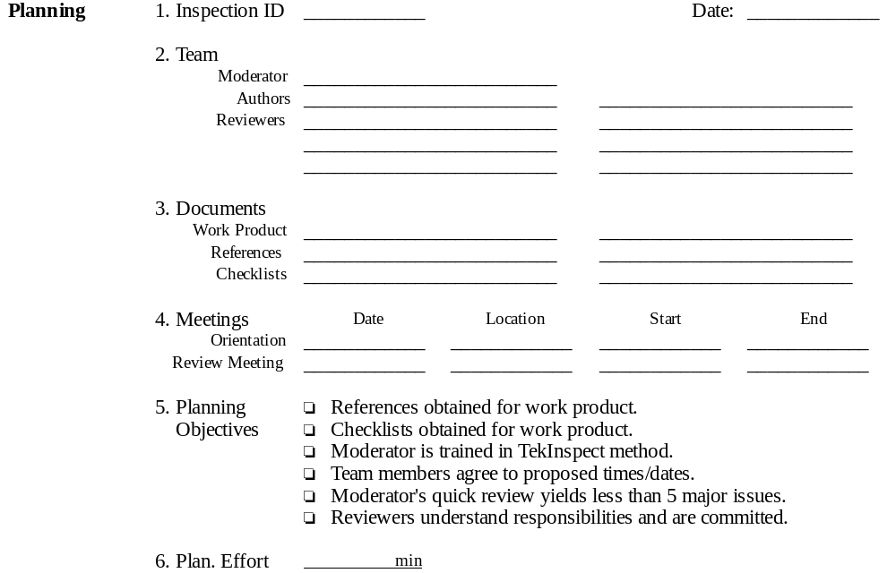
Planning Data

Slide 17
Orientation
Planning
Orientation
Preparation
Review Mt.
Rework
Verify
Objectives
  Author provides overview of the work product to be inspected.
  Reviewers obtain review package.
  Preparation goals established.
  Reviewers commit to participate.
Procedure
  Moderator, Reviewers, and Author attend short meeting.
  Moderator distributes review package.
  Author presents overview, if necessary.
  Scribe duty for Review Meeting is assigned.
  Moderator reviews preparation procedure, if necessary.

Slide 18
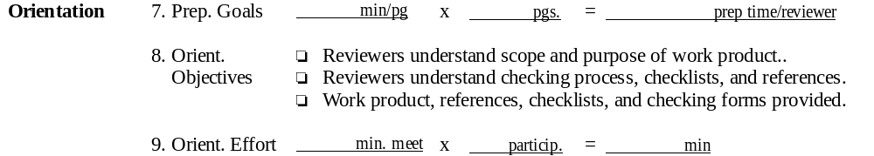
Orientation Data

Slide 19
Preparation
Planning
Orientation
Preparation
Review Mt.
Rework
Verify
Objectives
  Find maximum number of non-minor issues in work product.
Procedure for reviewers:
  Allocate recommended time to preparation process.
  Perform individual review of work product.
  Use checklists and references to focus attention.
  Note critical, severe, and moderate issues on Reviewer Data Form.
  Note minor issues and author questions on work product.

Slide 20
Tektronix Issue Classification
Critical
  Defects that may cause the system to hang, crash, produce incorrect results or behavior in areas central to the system’s purpose, or corrupt user data. No known work-arounds.
Severe
  Defects that cause incorrect results or behavior with known work-arounds. Although the system could be useable, large and/or important areas of the system’s functionality are affected.
Moderate
  Defects that affect limited areas of functionality that can either be worked around or ignored by the customer. They do not severely affect the utility of the system.
Minor
  Defects that can be overlooked with no loss of functionality. Minor defects are typically cosmetic in nature, such as a missing comma in the documentation or a column of figures that do not quite line up on the screen.

Slide 21
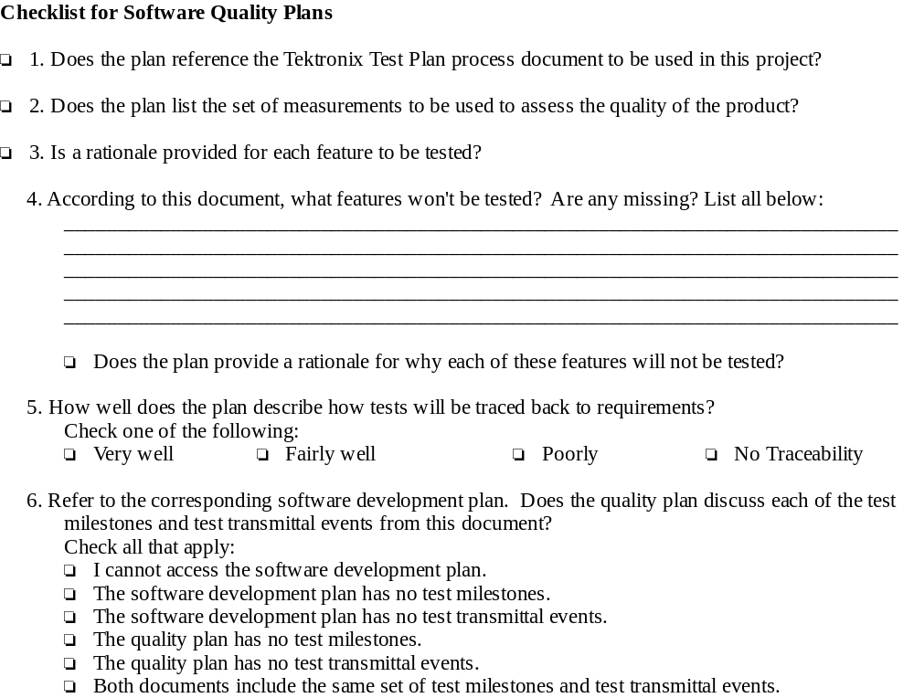
Example checklist

Slide 22
Example references
Corporate standards:
  IBU Procedure for Software Quality Plans
Exemplary documents:
  Sushi Software Quality Plan
High quality reference texts:
  Software Quality: Concepts And Plans, Ch. 13 (Plan following an industrial model), Robert Dunn.
On-line resources:
  http://flute.lanl.gov/SWQA/SMP.html

Slide 23
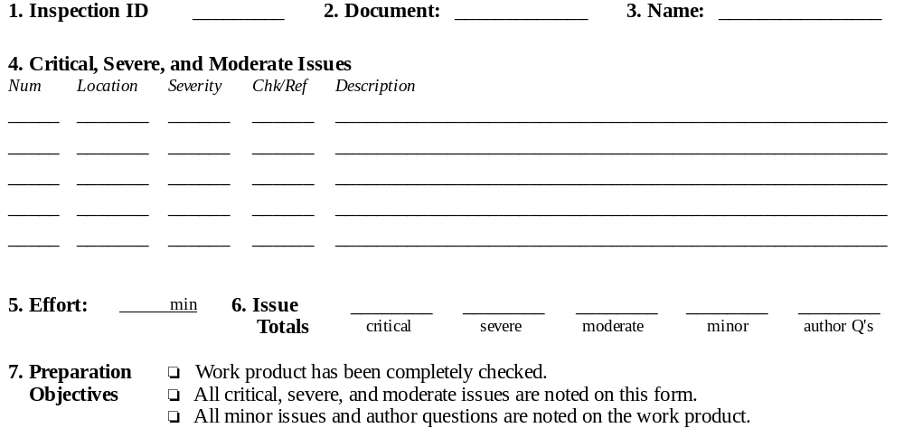
Preparation Data

Slide 24
Why not record all comments on the work product?
Advantages of Reviewer Data Sheet:
  Minor issues are “pre-filtered” from review meeting, saving meeting time.
  Reviewers articulate issues clearly during preparation, saving meeting time.
  Preparation statistics gathering simplified.
  Preparation effectiveness (% true defects, % redundancy) and checklist effectiveness is measurable.
  Issues can be presented in order of importance.
  Data sheet indicates effectiveness of checklists.
Disadvantages of Reviewer Data Sheet:
  Requires extra time (15 minutes?)
  Discourages last minute preparation.
  Makes quality of preparation more visible.

Slide 25
Review Meeting
Planning
Orientation
Preparation
Review Mt.
Rework
Verify
Objectives
  Create consolidated, comprehensive listing of non-minor issues.
  Provide opportunity for group synergy (new issue discovery).
  Improve reviewing skill by observing others.
  Create shared knowledge of work product status.
Procedure
  Moderator proceeds through work product sequentially, requesting issues.
  Reviewers raise issues.
  Scribe notes issues on Scribe Data Sheet.
  Scribe Data Sheet is visible to everyone (use projector).
  Issue discussion is minimized.

Slide 26
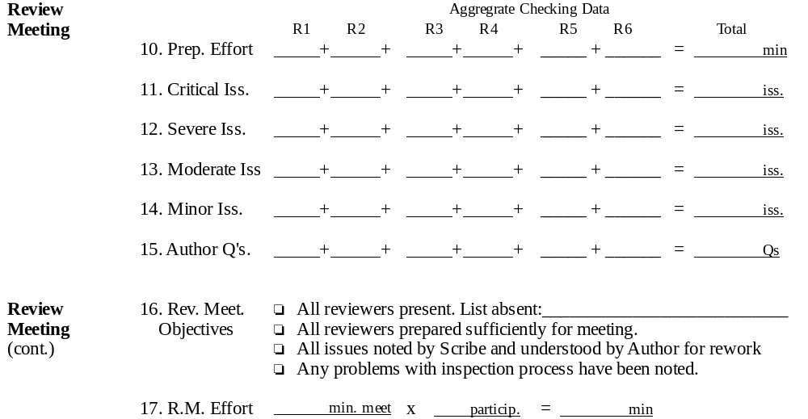
Review Meeting Data

Slide 27
Rework
Planning
Orientation
Preparation
Review Mt.
Rework
Verify
Objectives
  Assess each issue, determine if it is a defect, and remove it if necessary.
  Produce a written disposition of each non-minor issue.
  Resolve minor issues as necessary.
Procedure
  Author obtains Scribe Data Sheet containing consolidated issues list as well as copies of work products.
  Author assesses each issue and notes action taken using Author Data Sheet.
  Author determines the ‘type’ of each defect (reqs/spec/design/imp, etc.)
  When finished Author provides Author Data Sheet and reworked product to Moderator to Verify.

Slide 28
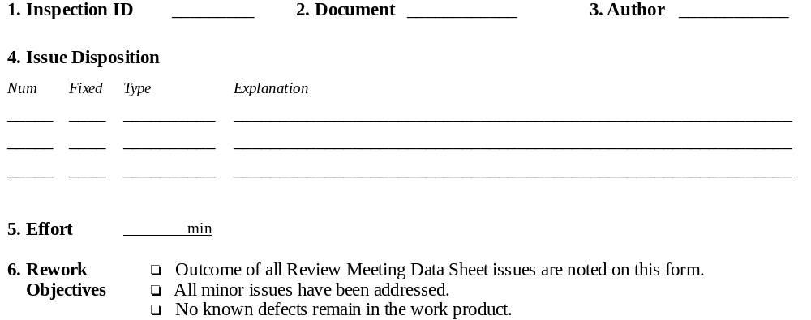
Rework Data

Slide 29
Verify
Planning
Orientation
Preparation
Review Mt.
Rework
Verify
Objectives
  Assess the (reworked) work product quality.
  Assess the inspection process.
  Pass or fail the work product.
Procedure for moderator:
  Obtain reworked product and Author Data Sheet from Author.
  Review work product and data sheet for problems/issues.
  Consult with review team on problems/issues as necessary.
  Provide recommendation for work product.
  Perform sign-off with reviewers.
  Compute summary statistics for inspection.
  Generate any process improvement proposals.
  Save work product and Data Sheets in project filing cabinet.
  Enter review data into quality engineering database.

Slide 30
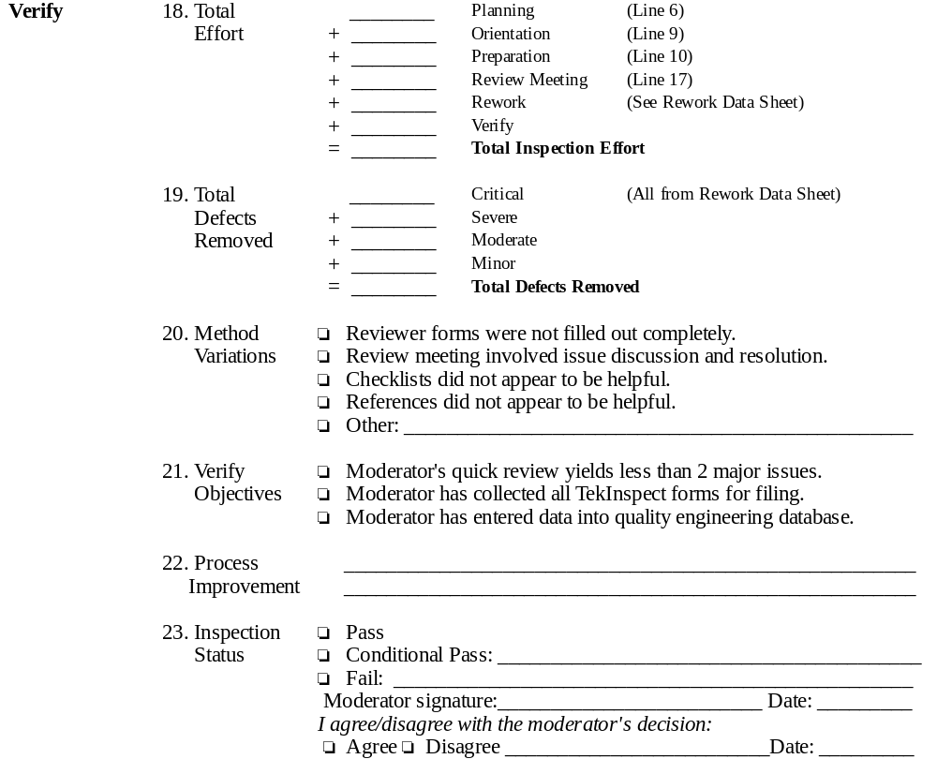
Verify Data

Slide 31
Inspection Critical Success Factors
Checklists
Preparation
Measurement
The moderator

Slide 32
Critical Success Factor: Checklists
Checklists guide reviewers to areas prone to defects.
Checklists may be stated as a yes/no question:
  “Are all strings null terminated?”
Checklists can also stimulate mental modelling:
  “After a fork, what happens if a child exits immediately?”
Checklists should be combined with general analysis.
  Don’t trust checklists to be comprehensive!
Checklists are specific to work product type and development phase.

Slide 33
Critical Success Factor: Effective Preparation
Effective preparation requires both:
  Comprehension: the nature of the entire document.
  Analysis: inter-document consistency and adequacy.
Focus on:
  What is present but not adequate.
  What is missing but should be there.
  What unique skills and experiences can you bring to bear on the work product?
Allocate enough time to prepare!
  Make multiple passes over document.
  Let it “sit overnight”.
  Don’t prepare right before the review.

Slide 34
Critical Success Factor:
Measurement
The goal of TekInspect is to detect and remove all defects efficiently and completely.
We measure:
  Time spent on each phase.
  Number of issues of each type discovered.
  Utility of review meeting, checklists, etc.
Analysis over time suggests:
  New and better checklist items.
  Improvements to inspection process,by identifying poor quality review.
  Improvements to software development process, by identifying poor quality work products.
  Improvements to standards.

Slide 35
Critical Success Factor:
The moderator
Indicators of effective inspection moderators:
  Work products are inspected when ready.
  Meeting dates are aggressive but do-able.
  Author overviews are useful and omitted when unneeded.
  Checklists and reference materials are useful.
  Review meeting focuses on issue detection, not discussion.
  Author does not feel threatened or hurt by Inspection.
  Rework is verified carefully.
  Improvements to inspection and software development process are discovered.
  Participants feel the method effectively improved quality.
  Everyone wants to do it again!

Slide 36
Further references
Software Inspection, Tom Gilb and Dorothy Graham, Addison-Wesley, 1993.
The WWW FTR Archive,
  http://www.ics.hawaii.edu/~johnson/FTR/
Software Inspection: An Industry Best Practice, David Wheeler, Bill Brykczynski, and Reginald Meeson.

